Slide 1
INFO6003 Lab-05 (You might not need all 10 slides)
Gihan Shamike Liyanage
1142109

Slide 2
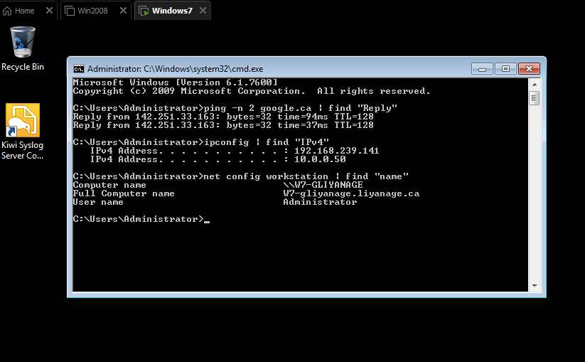
Slide #1

Slide 3
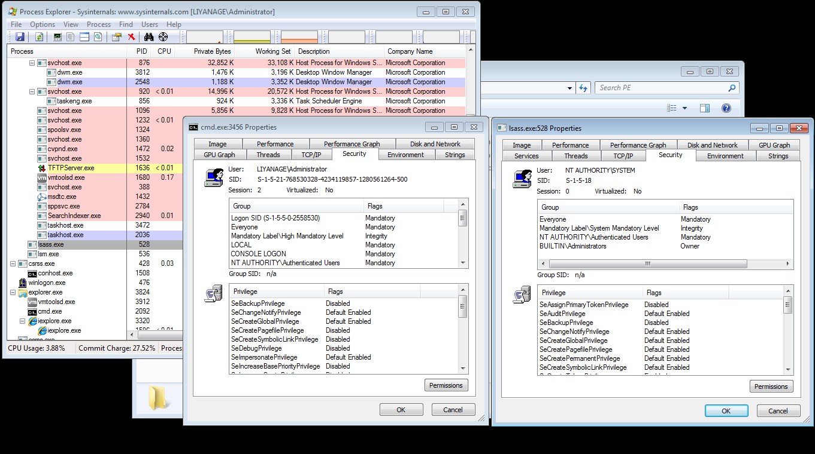
Slide #2

Slide 4
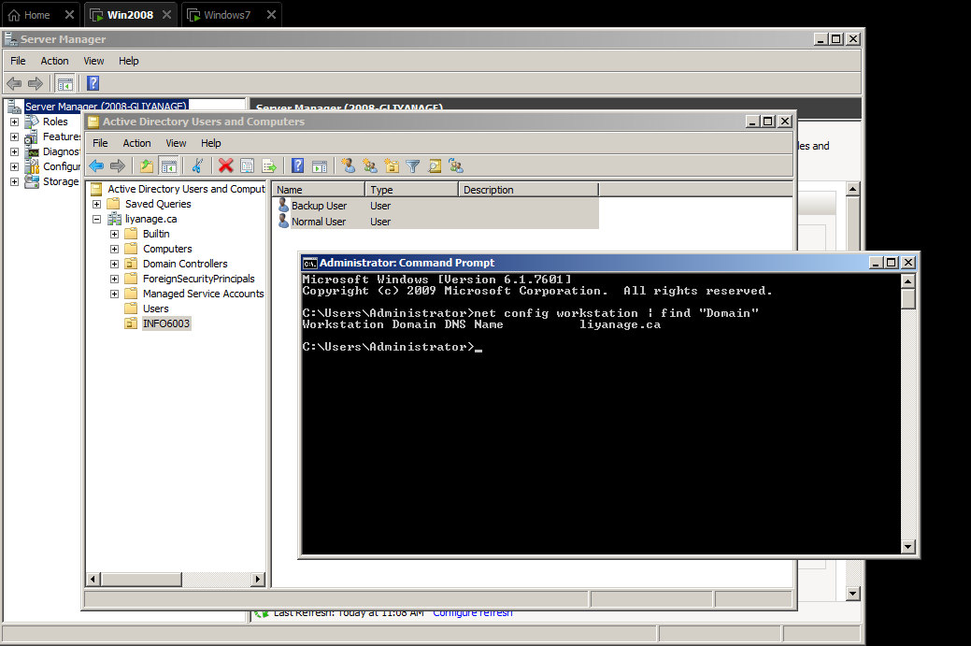
Slide #3

Slide 5
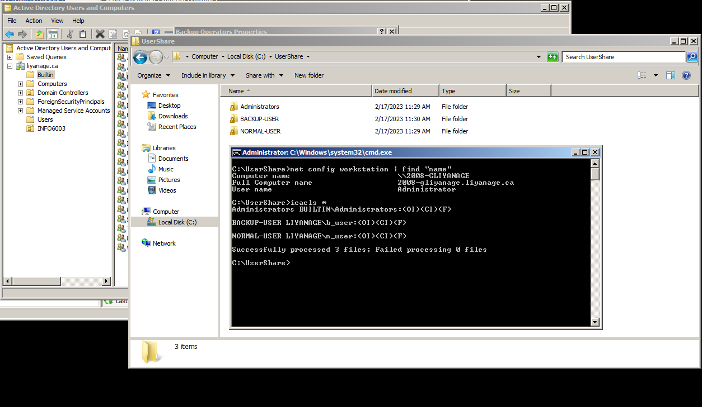
Slide #4

Slide 6
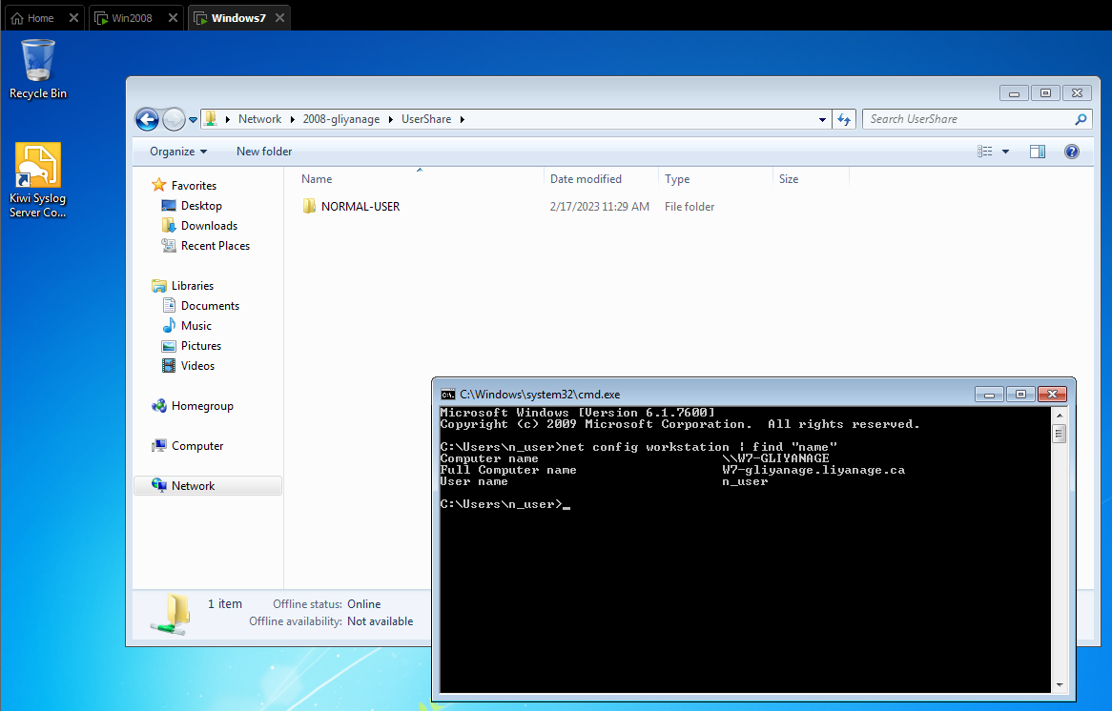
Slide #5

Slide 7
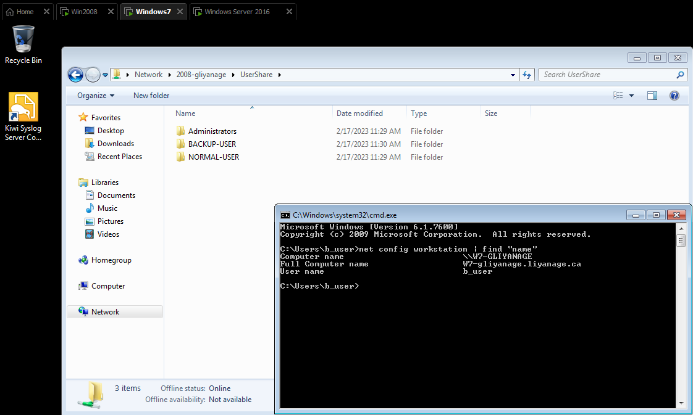
Slide #6
Access-based enumeration displays only the files and folders that a user has permissions to access. If a user does not have Read (or equivalent) permissions for a folder, Windows hides the folder from the user’s view. But Backup Operators can override security restrictions for the sole purpose of backing up or restoring files and b_user user is a member of Backup Operators.

Slide 8
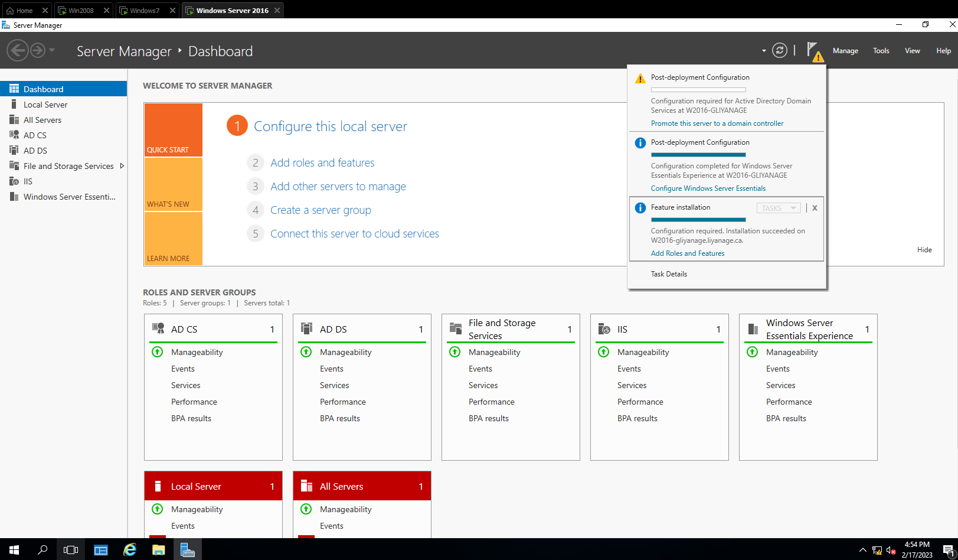
Slide #7

Slide 9
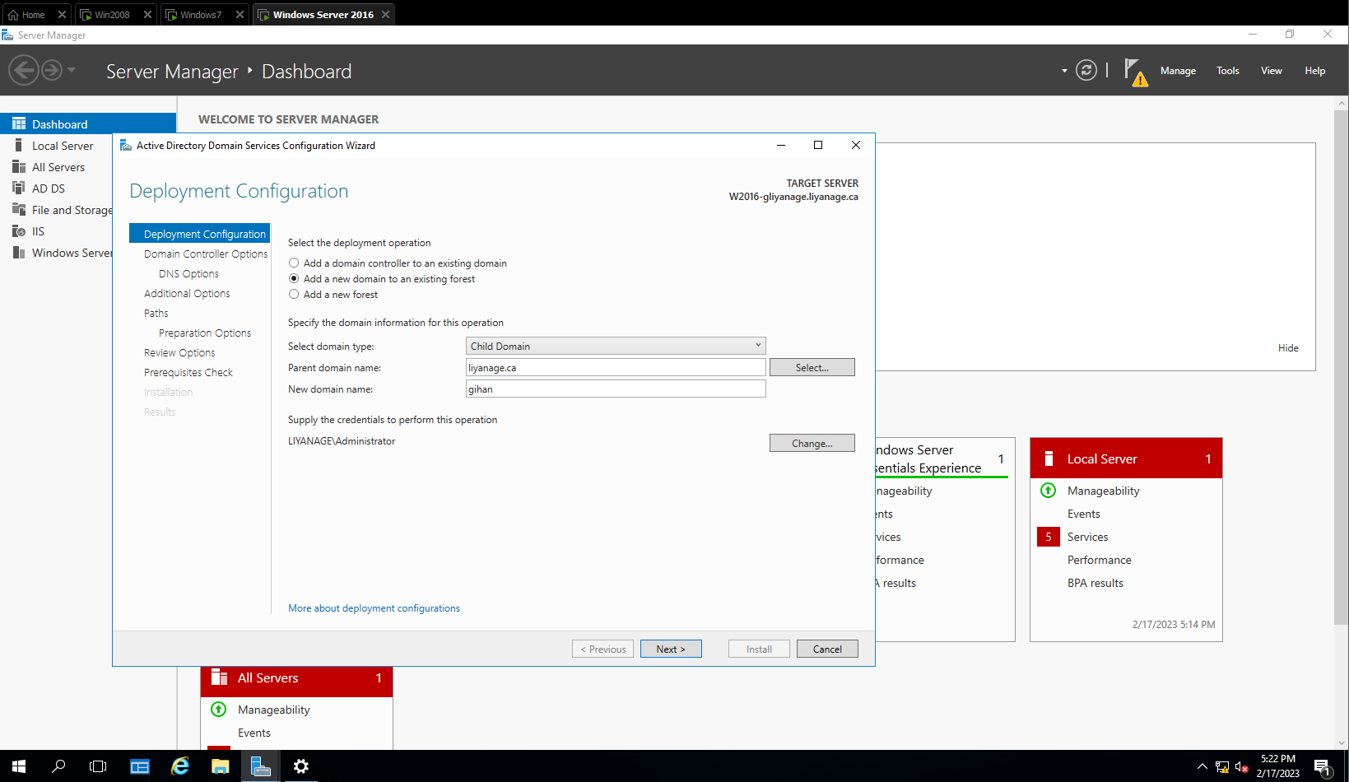
Slide #7

Slide 10
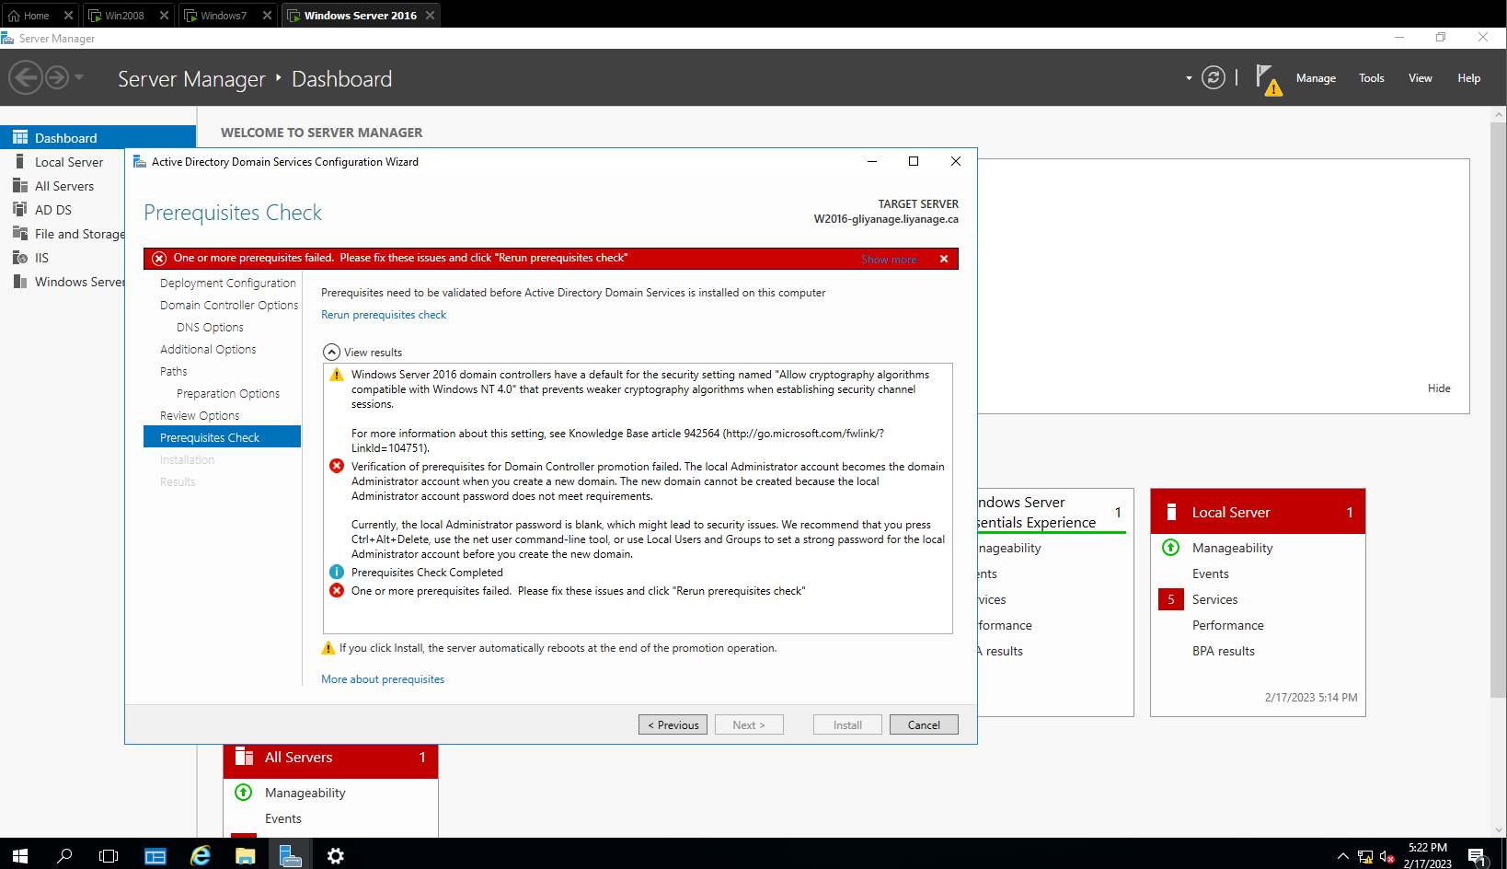
Slide #7

Slide 11
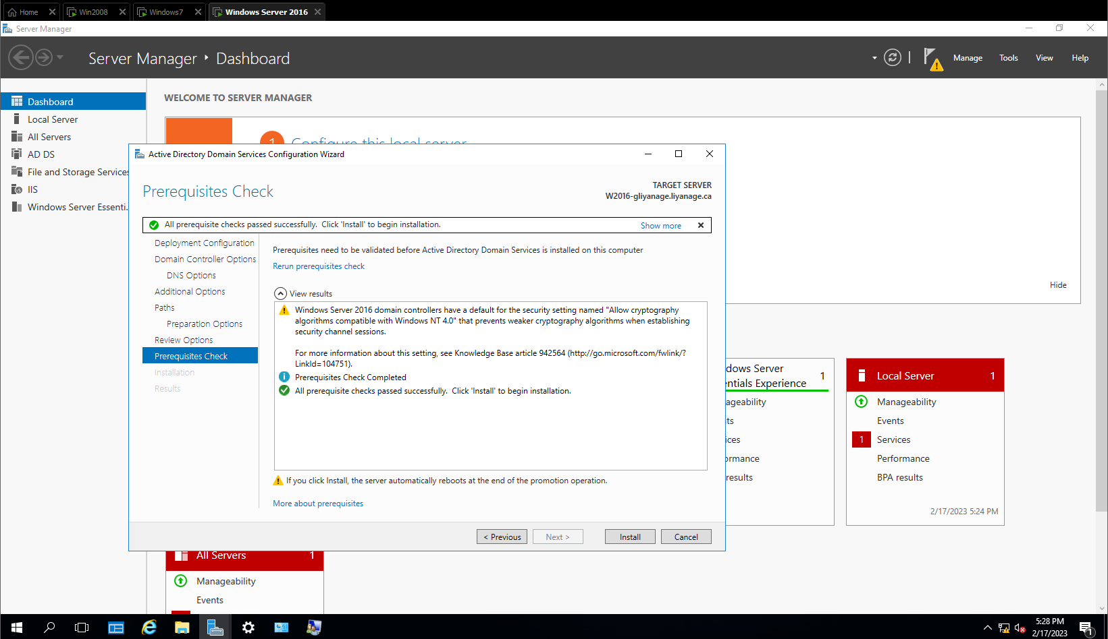
Slide #7 (After satisfying password requirement)

